Slide 1
Brassiers (Under-Garments)
Mihir Khandelwal
331

Slide 2
OBJECTIVE
The main objective of this paper is to highlight the quality testing parameters that are essential for manufacturing of undergarments following the American Society for Testing Materials (ASTM) and American Association of Textile Chemists and Colorists (AATCC) standard norms known worldwide.

Slide 3
STANDARD PERFORMANCE SPECIFICATION
The standard is issued under ASTM D7019 [15]. The performance specification covers fabrics used in underwear, brassieres, slips, and lingerie.

Slide 4
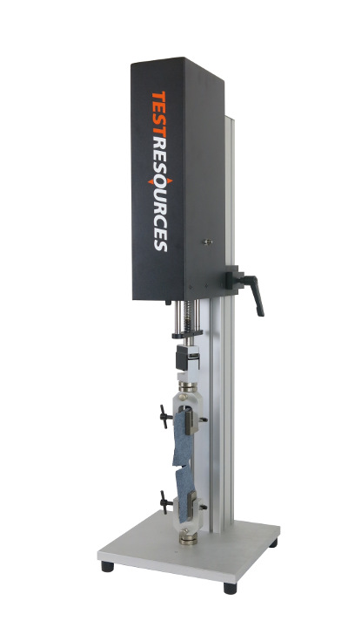
TEST METHODS
Breaking Strength (woven fabrics only)
ASTM Standards D 5034 Test Method for Breaking Strength and Elongation of Textile Fabrics covers the Grab Test procedures for determining the dry-breaking strength and elongation of most textile fabrics using a constant-rate-of-extension (CRE) tensile testing machine.

Slide 5
Resistance to Yarn Slippage (woven fabrics only)
The test method ASTM Standards D 434 covers the determination of the resistance to slippage of weft yarns over warp yarns, or warp yarns over weft yarns, using a standard seam. The test involves a tensile testing machine, a pair of dividers, metal rule, metal clamp, and sewing machine.

Slide 6
Yarn distortion (woven fabrics only)
The test method ASTM Standards D 1336 covers the measurement of yarn distortion of one set of yarns over the other in woven cloth following the application of surface friction in a Fabric Shift Tester.

Slide 7
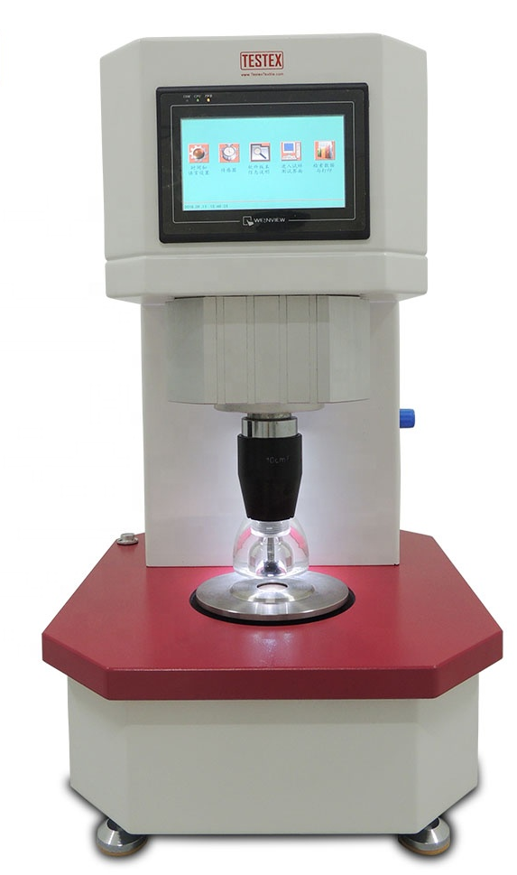
Bursting Strength (knit fabrics only)
ASTM Standards D 3786 Test Method for Bursting Strength of Textiles-Diaphragm Bursting Strength Tester Method is used as a multidirectional tensile test to identify a failure in the direction of least resistance for evaluating the physical strength and fiber bond.

Slide 8
Dimensional Change
Dimensional stability is the ability of textile materials to maintain or return to its original geometric configuration.
Dimensional property of a fabric is greatly influenced by laundering (AATCC Method 135) and dry cleaning (AATCC Method 158).

Slide 9
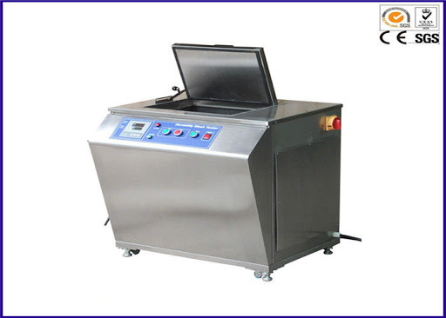
Colour Fastness
It is a fabric’s ability to retain its colour throughout its intended life cycle influenced by water, light, rubbing, washing, perspiration etc.
LAUNDERING MACHINE

Slide 10
Fabric Appearance
The test method is intended to determine the Smoothness Appearance (SA) of flat fabric specimens as directed in AATCC Method 124.
Evaluation is performed using a standard lighting and viewing area by rating the appearance of specimens in comparison with appropriate reference standards.

Slide 11
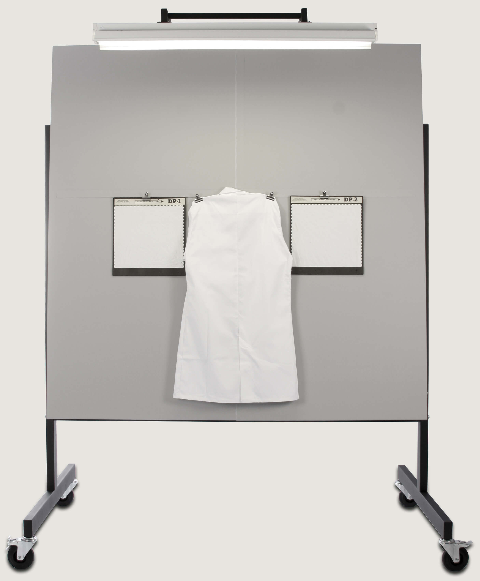
AATCC LIGHT AND VIEWING AREA

Slide 12
Flammability
The flammability test and requirements shall meet or exceed the Flammable Fabrics Act mandatory standards as specified in 16 CFR 1610.
All fabrics will burn; however, it is the ease, speed, and intensity of burning that determines whether a fabric is hazardous or not. Factors that directly affect burning characteristics are fibre content, weight, and fabric construction.

Slide 13
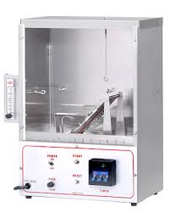
FLAMMABILITY CABINET

Slide 14
CONCLUSION
There are two things defining good quality underwear: comfort and style that represents our personality. The primary determinant of an undergarment quality depends on its fabric, construction and fit.
There should be no loose threads or puckered material under the stitching lines.
Every manufacturer should maintain a highquality system of inspection policy, follow the test methods and specifications.

